Slide 1
CPS2 PROJECT
Presented by
Dharmalingam Dhayananth
Aninda Maulik

Slide 2
Context and motivation of the Work

Slide 3
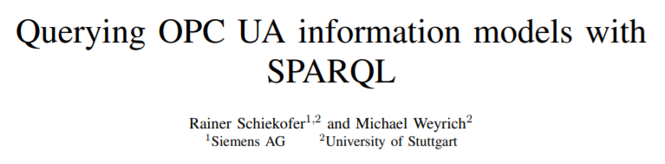

Slide 4
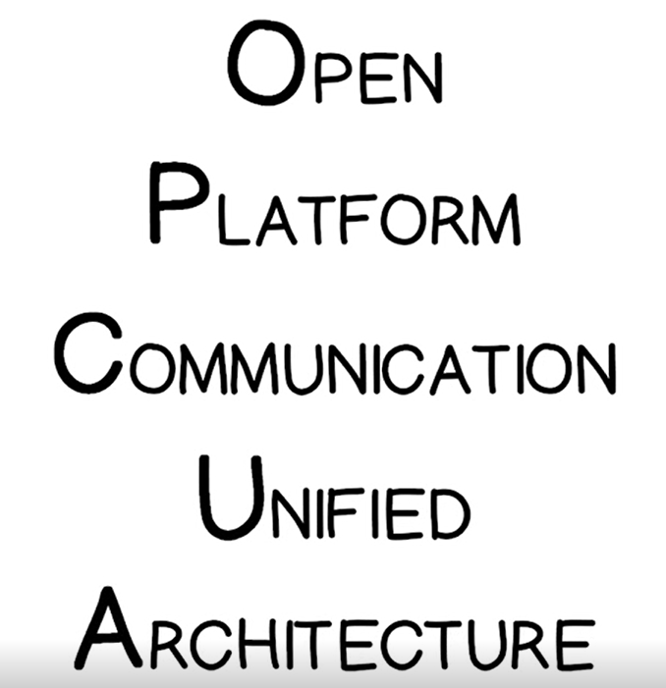

Slide 5
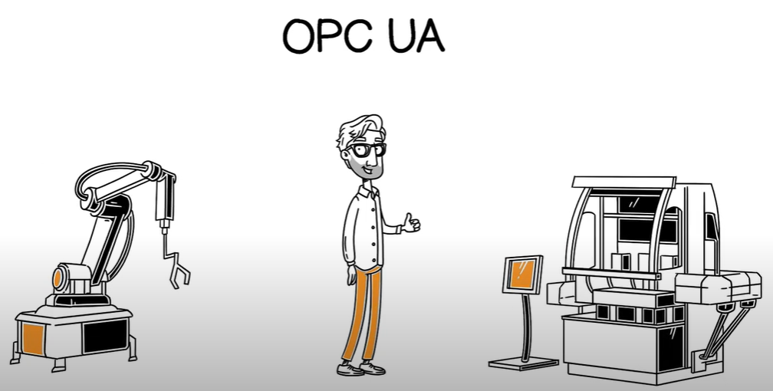
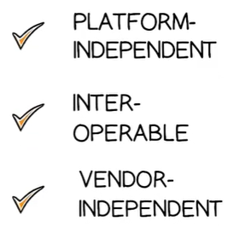

Slide 6


Slide 7
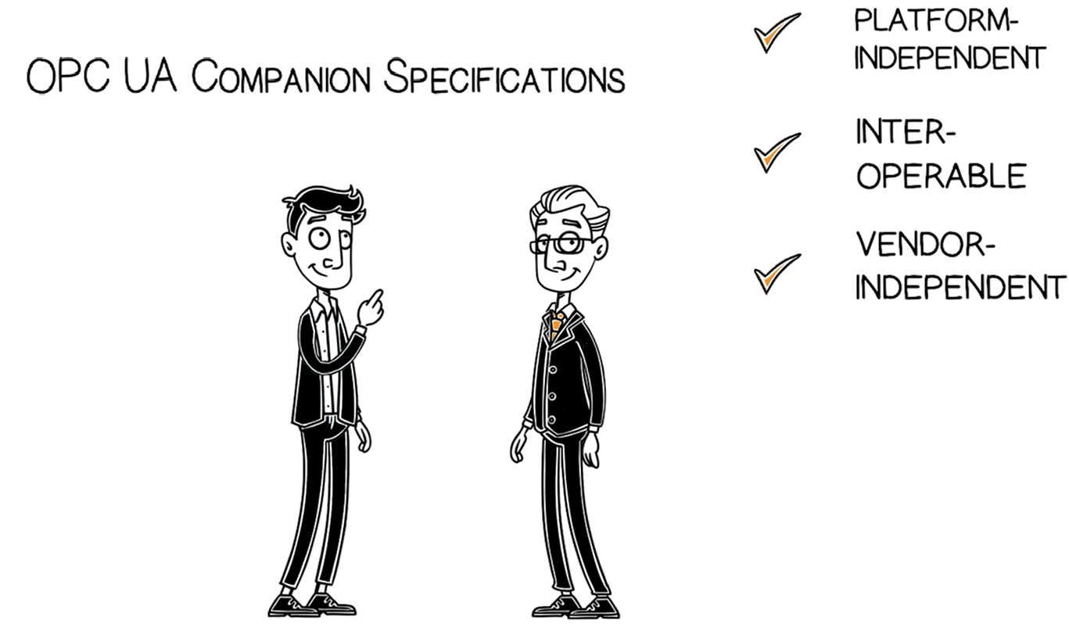

Slide 8
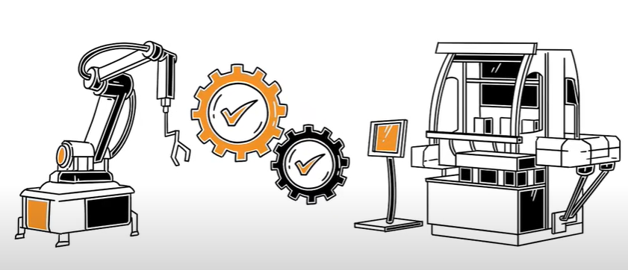
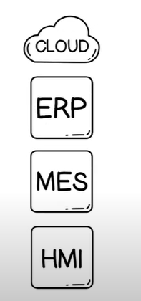

Slide 9
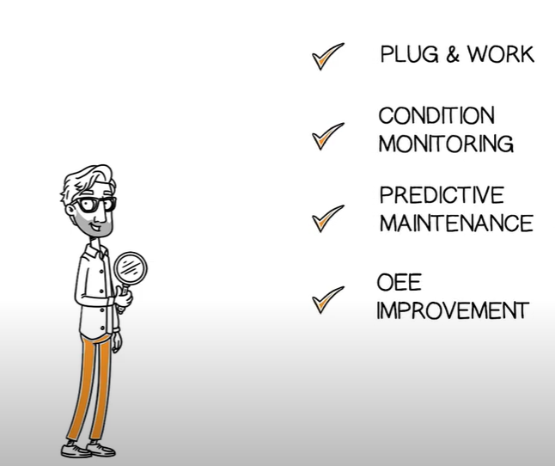

Slide 10
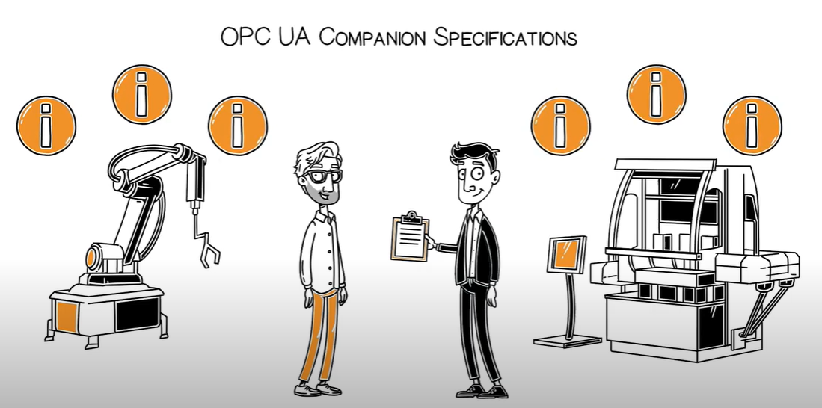

Slide 11
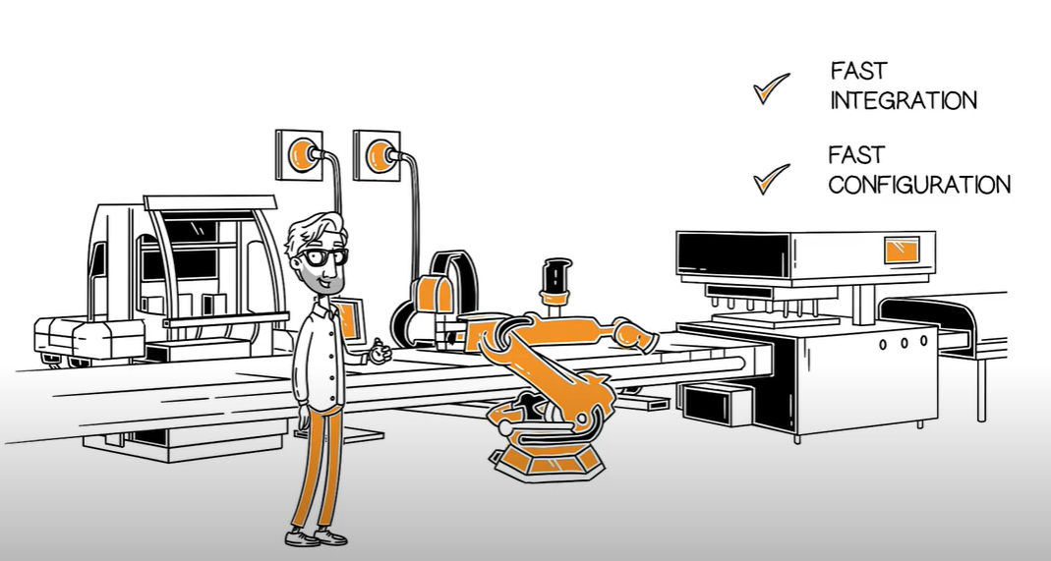

Slide 12
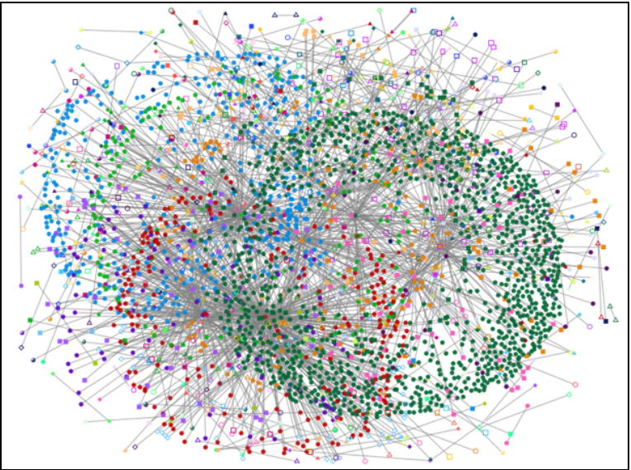

Slide 13
Objective
Query OPC UA graphs through SparQl
Transform OPC UA queries to SparQl
Bypass the flaws through SparQl

Slide 14
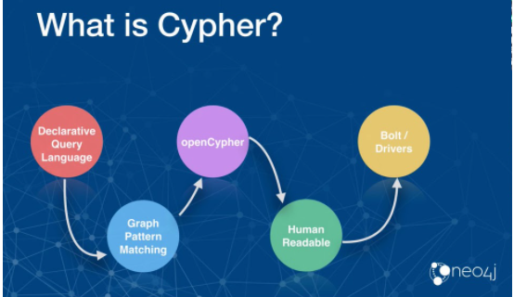


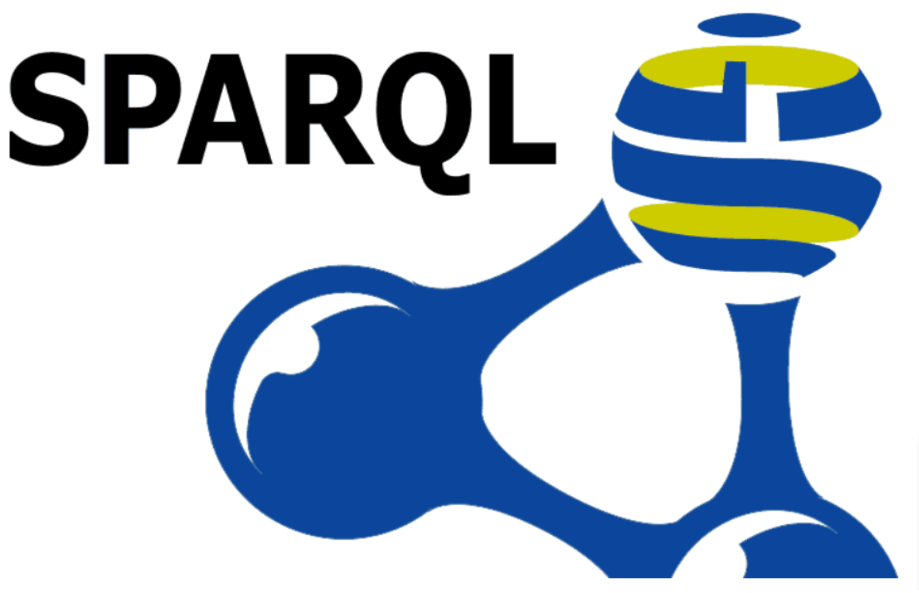
Research questions

Slide 15

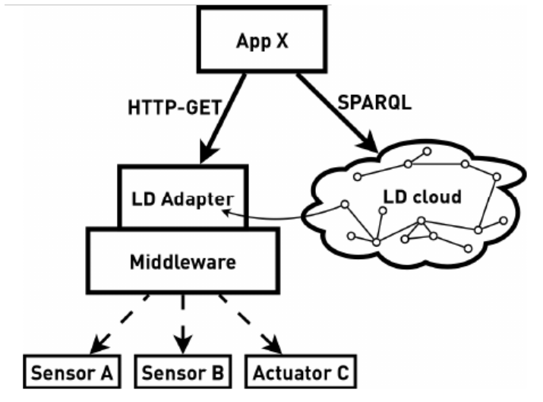
State of the art
Integrating Industrial Middleware in Linked Data Collaboration Networks (Markus Graube, Leon Urbas and Jan Hladik)
They found that current industry systems only digitalized in certain area and the data is considerablyasd usable to that specific to that related task.
Linked Data Adapter for OPC UA

